Slide 1
Fast.AI - NLP & Summary
Let’s do it! - Jeremy Howard

Slide 2

Our last session!

Slide 3
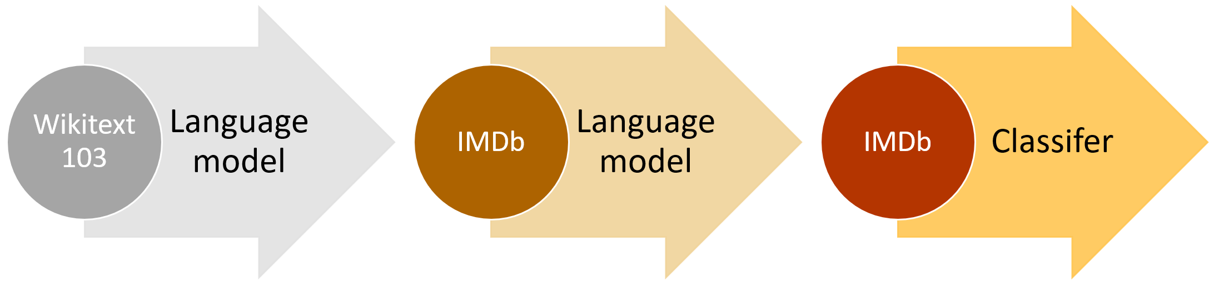
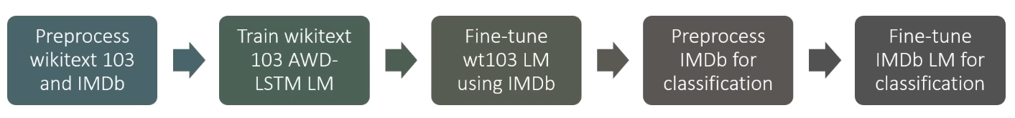
ULMFiT
AWD-LSTM
variable length backpropagation sequences (window-size)
Embeddings dropout
L2 regularization
Text Classification
Sequence Classification (time-series)
https://yashuseth.blog/2018/09/12/awd-lstm-explanation-understanding-language-model/

Slide 4
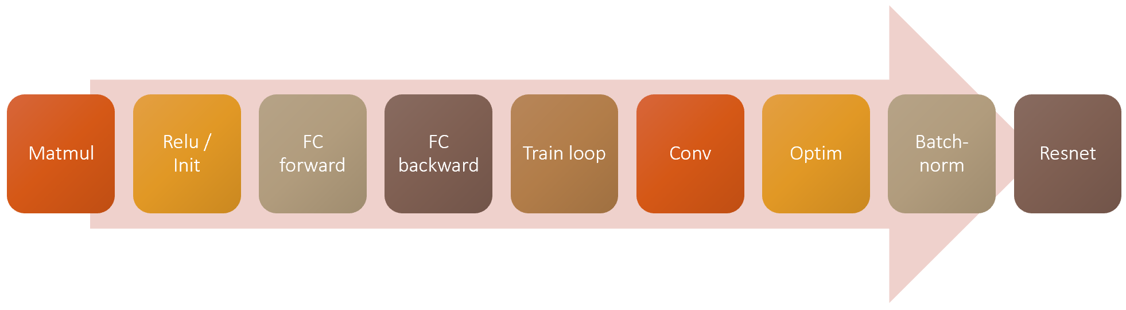
Recap: what did we learn?

Slide 5
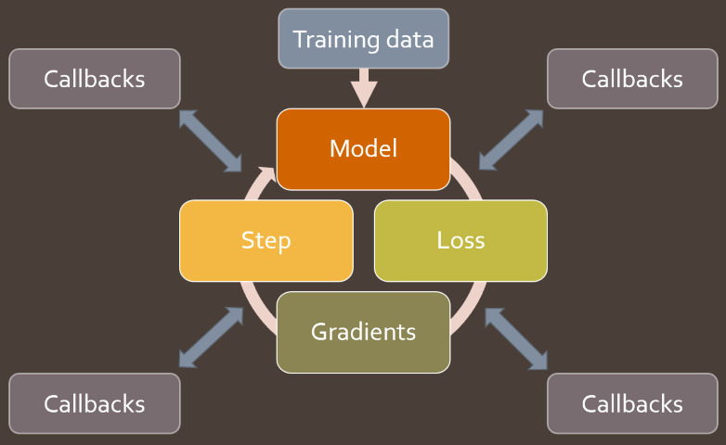
Creation of callbacks

Slide 6
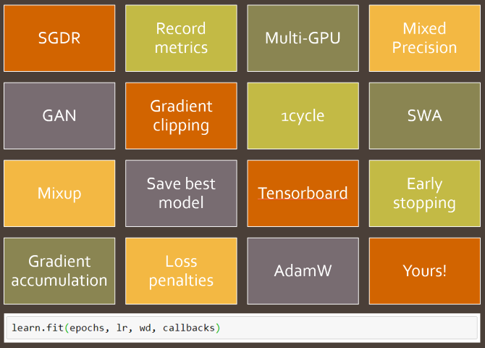
Utilizing callbacks
Batch Normalization
Layer Normalization
Weight Normalization
Optimizer
Regularization

Slide 7

But...
April 2019
(8 months ago)
⇒ A lot have happened.

Slide 8
Question:
Which latest advances in AI were not covered by the course?

Slide 9
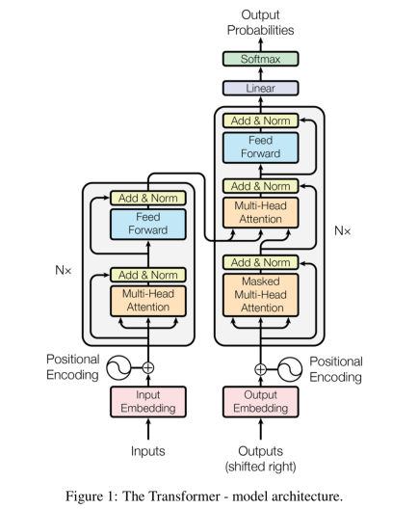

Transformers
BERT roBERTa DistilBERT alBERT

Slide 10
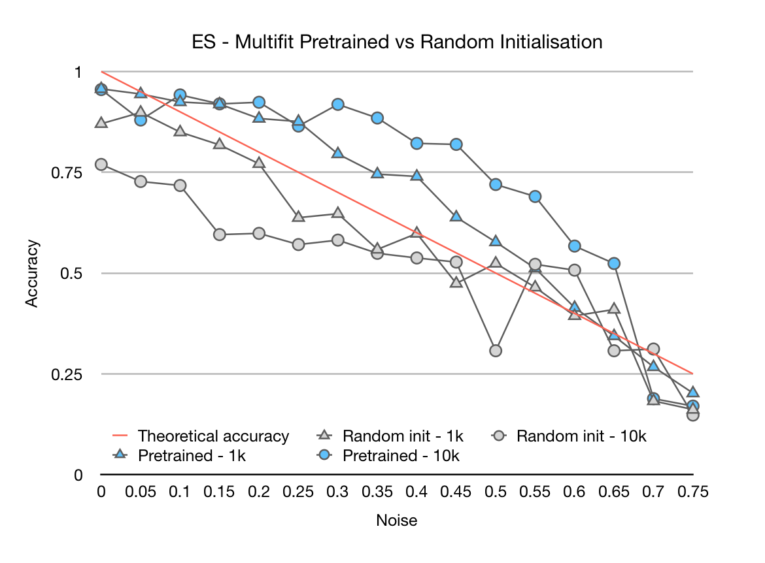
MultiFiT
Transfer learning between languages
https://nlp.fast.ai/classification/2019/09/10/multifit.html

Slide 11
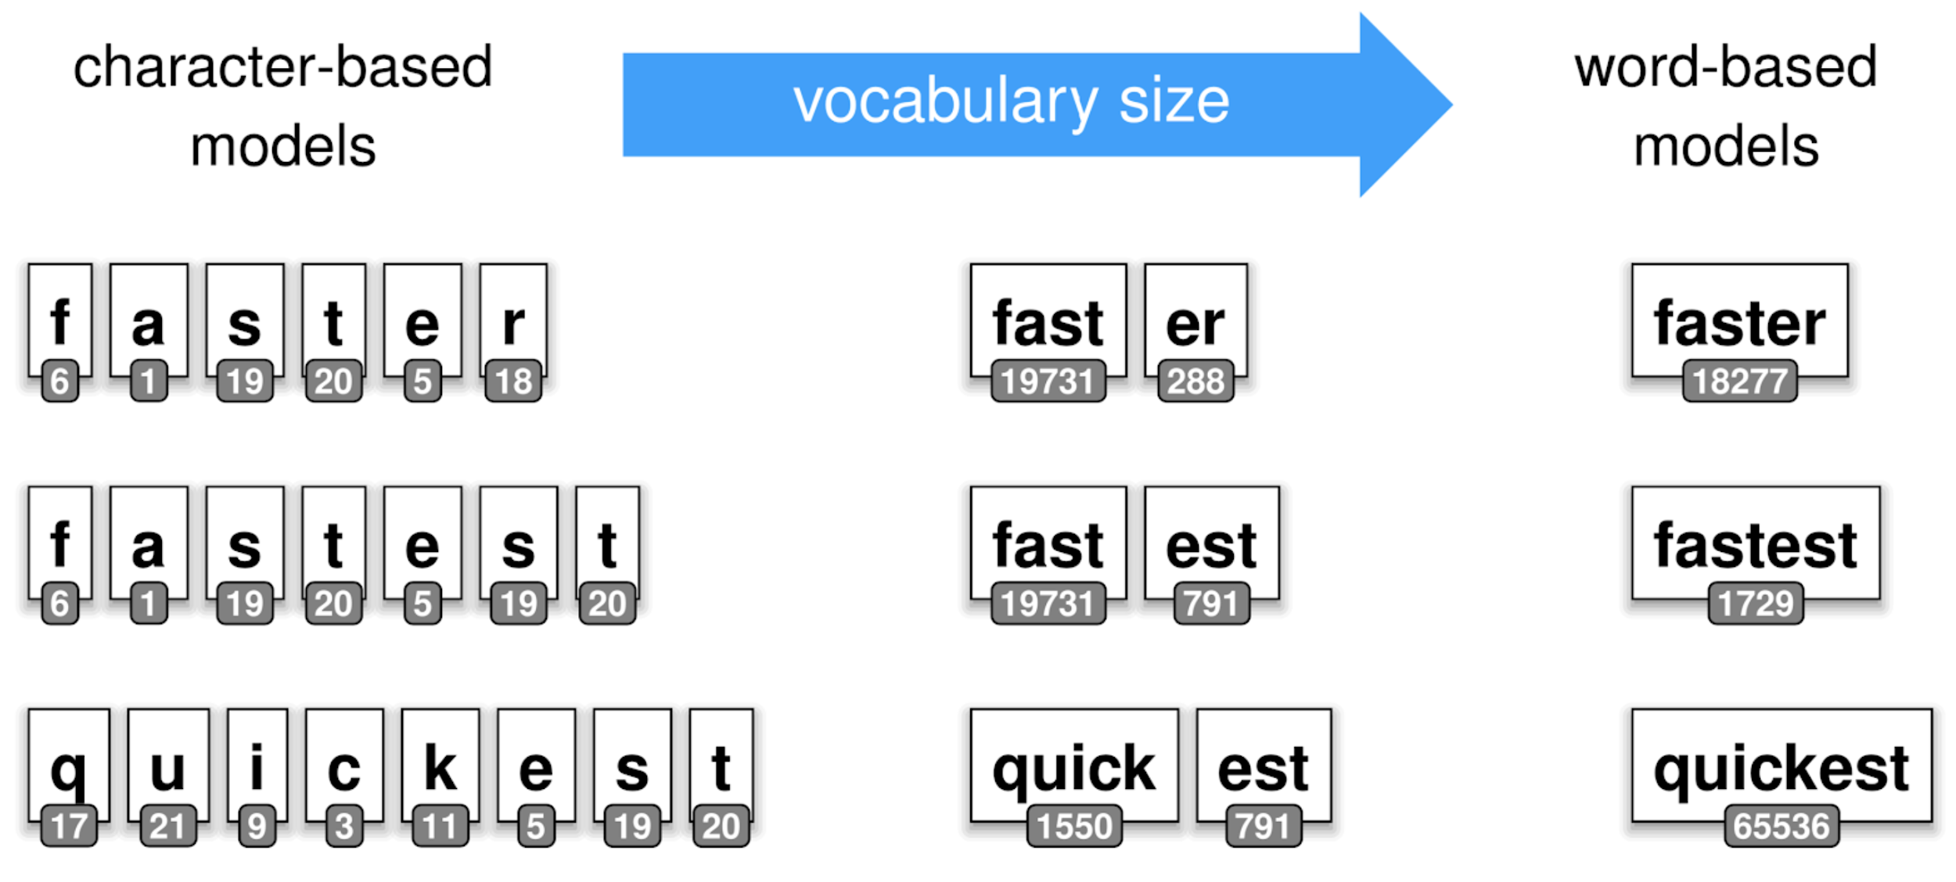
Sentencepiece
Letters < words
Letters < letter combinations < words
https://github.com/google/sentencepiece

Slide 12
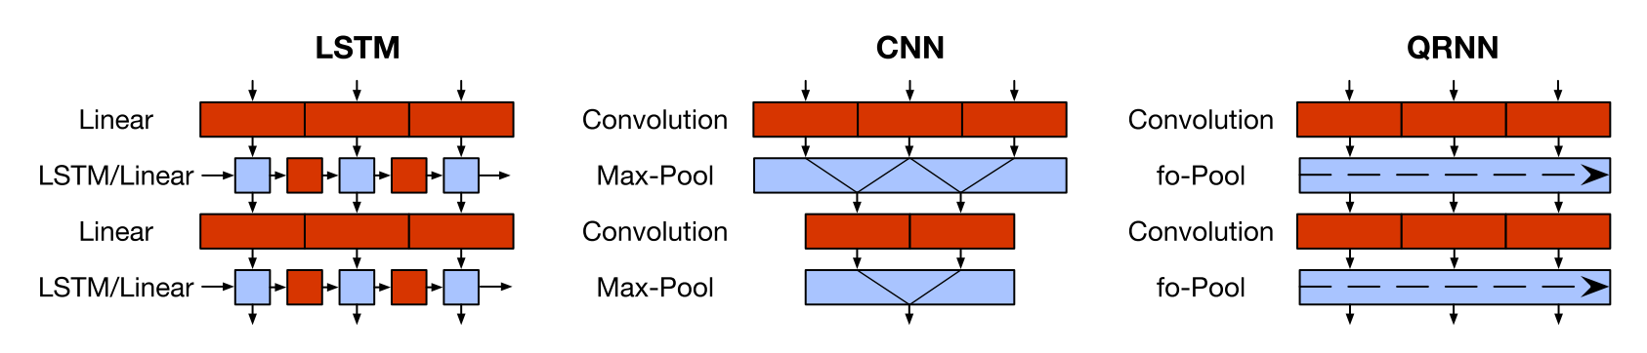
QRNN
Parallel ⇒ Faster
Pooling as concatenation operation
https://mlexplained.com/2018/04/09/paper-dissected-quasi-recurrent-neural-networks-explained/

Slide 13
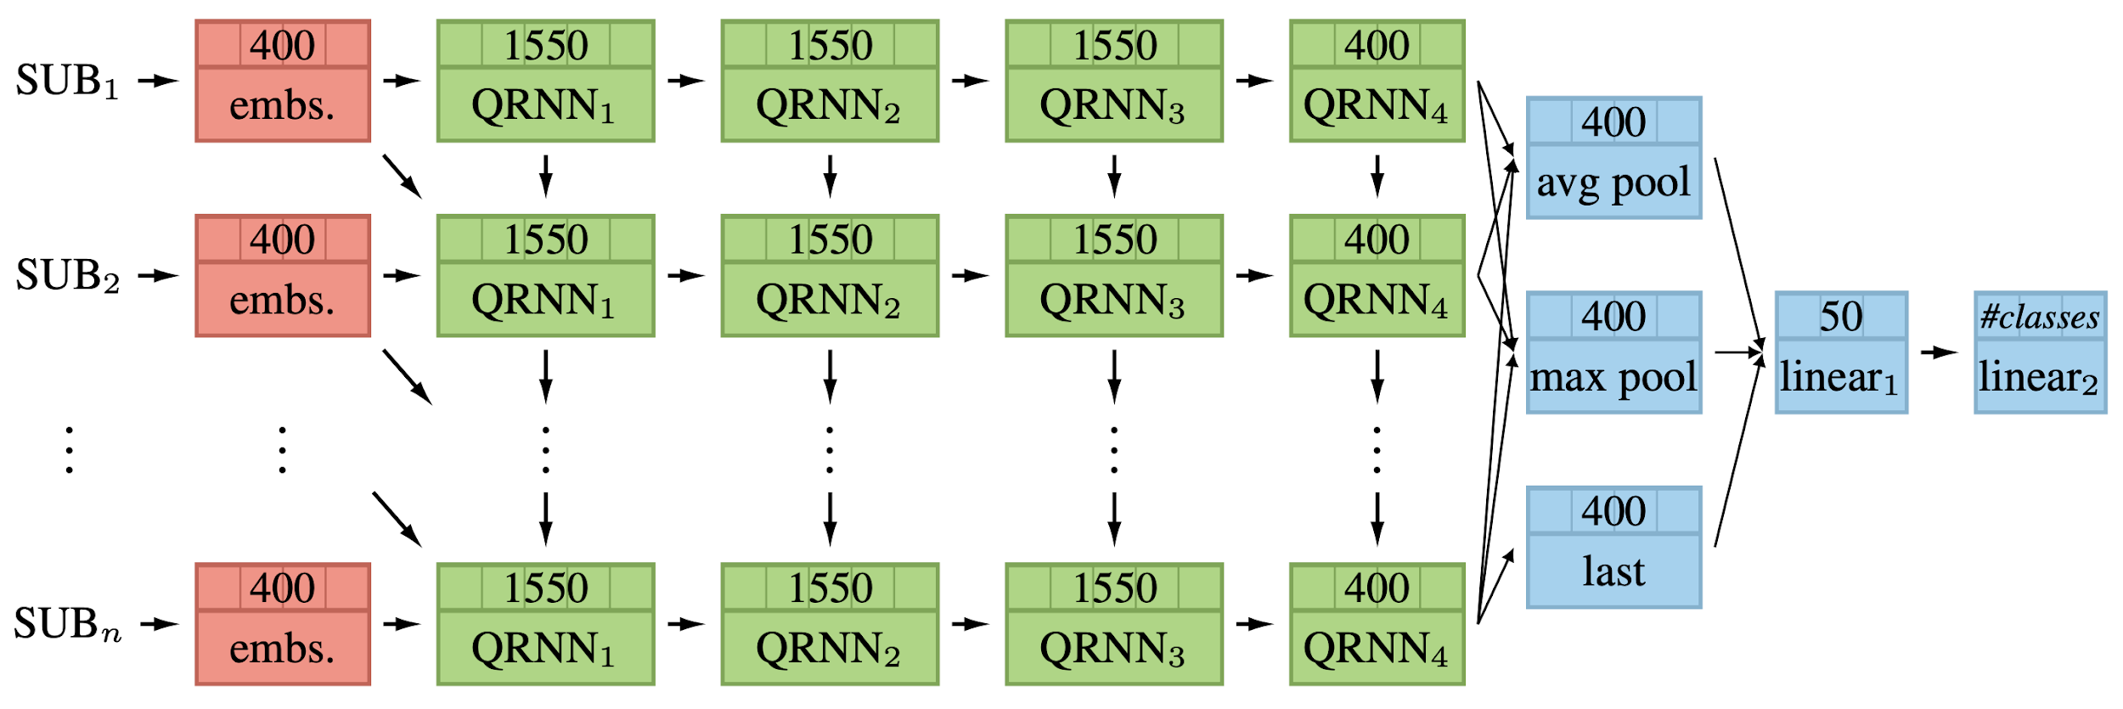
Architecture
Sub-word Embedding
QRNN
Linear head
https://github.com/n-waves/multifit

Slide 14
The Interview:
If you were an interviewer, who needs to test the knowledge and understanding of a candidate - what would you ask?

Slide 15

Reflection:
What was your best moment during the course?
Why?

Slide 16

Recommendations
Which recommendations will you give to the next course participants?

Slide 17
My takeaways
Giving a talk.
Helps to understand:
What we know
What’s still missing
Building a project.
Finding the missing pieces
Refactoring Don’t rewrite everything from scratch

Slide 18
Suggestions:
What can we do better next time?

Slide 19
Thank you!
Don’t let the pizza get cold

